Slide 1
EDA Analysis on R -Latheesh Vijo

Slide 2
INTRODUCTION:
The dataset at hand is a comprehensive record of sales transactions, capturing various aspects of each sale from multiple regions. The columns included in the dataset are "Transaction.ID", "Date", "Product.Category", "Product.Name", "Units.Sold", "Unit.Price", "Total.Revenue", "Region", and "Payment.Method". Each row represents an individual transaction, detailing the specific product sold, the quantity sold, the price per unit, and the total revenue generated from the sale. Additionally, the dataset specifies the date of the transaction, the geographical region where the sale occurred, and the method of payment used by the customer. This dataset is invaluable for analyzing sales performance, understanding customer preferences, and identifying trends across different product categories and regions.

Slide 3
Objectives:
* To find the how many units of product sold per category.
* Identify the highest and lowest price products
* Identify the trends over time
* To find the product needs according to region wise
* To identify which payment method is familier in a particular
* Determine the counts of the payment methods
region
* To find the statistics values of the numerical columns in the dataset.

Slide 4
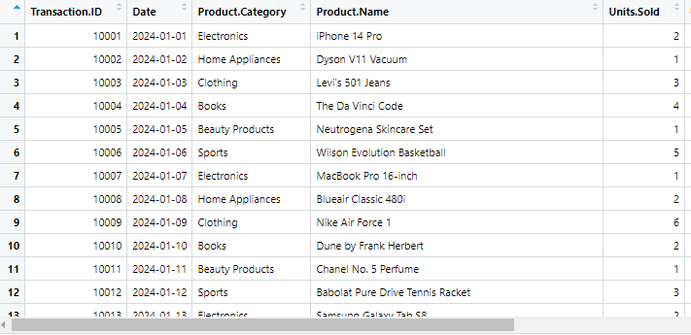

Slide 5
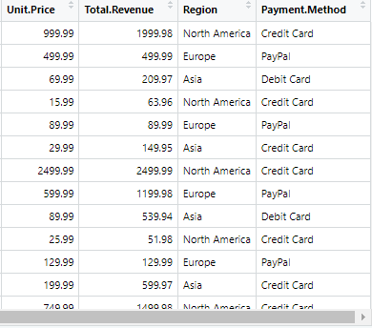

Slide 6
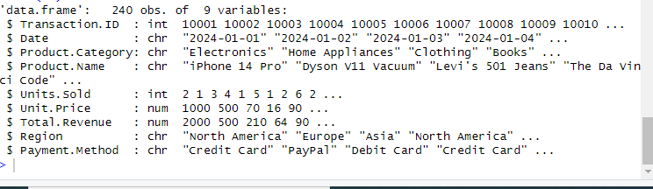
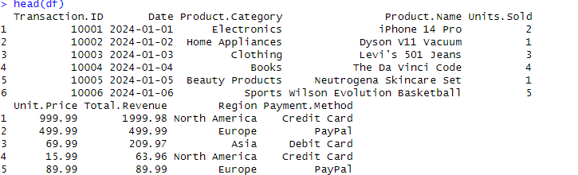

Slide 7
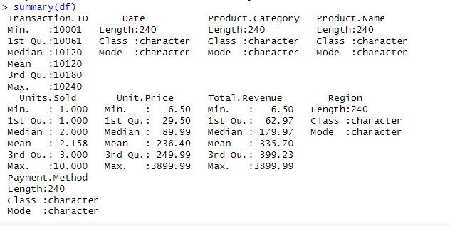


Slide 8
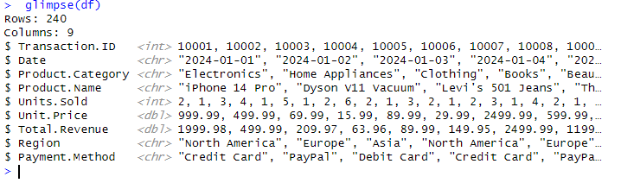


Slide 9
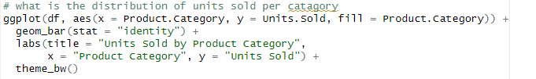
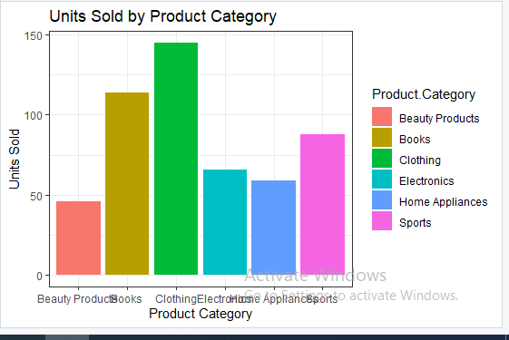
>

Slide 10

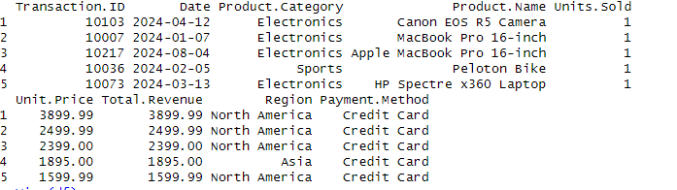

Slide 11

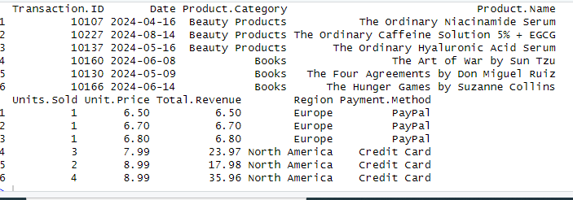

Slide 12
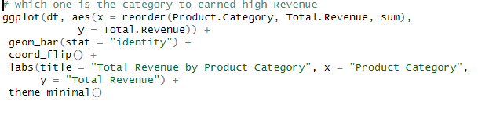
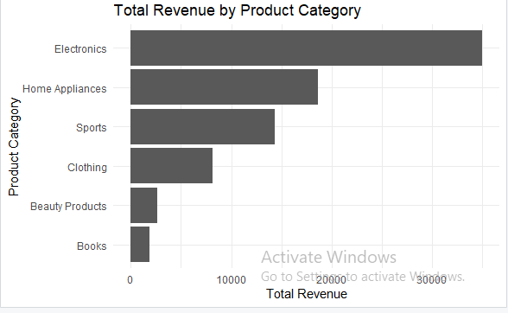

Slide 13
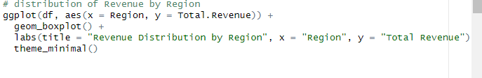
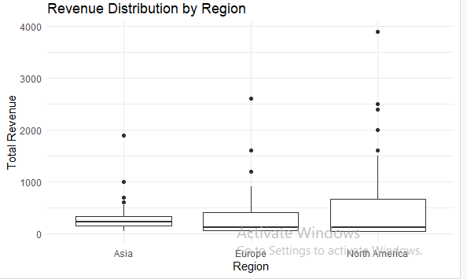

Slide 14
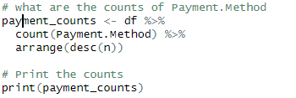

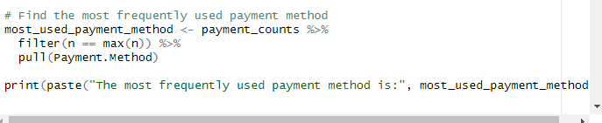

Slide 15

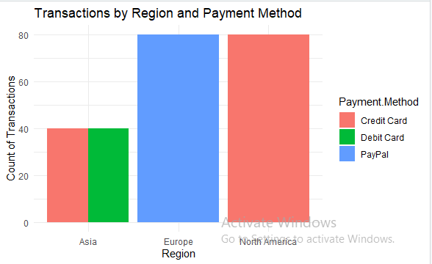

Slide 16
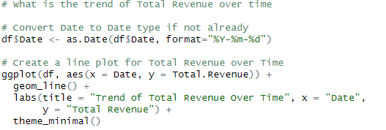
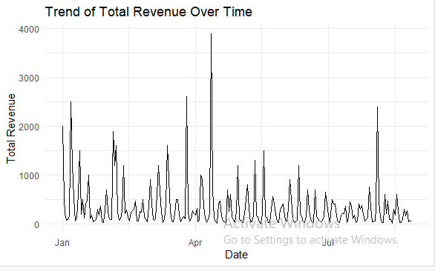

Slide 17
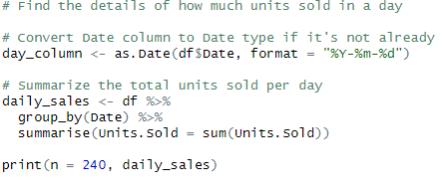
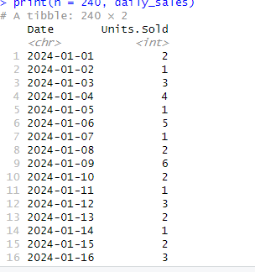

Slide 18
COCLUSION
In conclusion, this dataset serves as a crucial resource for analyzing sales transactions across various regions and product categories. By examining the detailed records of each transaction, including product information, sales volume, pricing, and revenue, one can gain deep insights into market dynamics and consumer behavior. Furthermore, the inclusion of payment methods and transaction dates allows for a comprehensive analysis of sales patterns over time. This data can be instrumental in making informed business decisions, optimizing sales strategies, and enhancing overall operational efficiency.

